Slide 1

Recommended Resources:
Selected Websites
Successful Match 2021

Slide 2
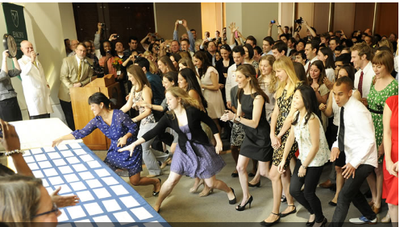
Match Day!
Only 12 months away…

Slide 3
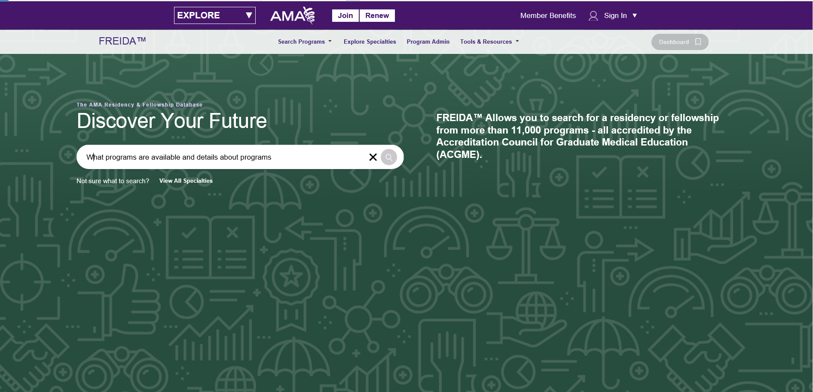
Go to: https://www.ama-assn.org
Under FREIDA you can search for programs

Slide 4
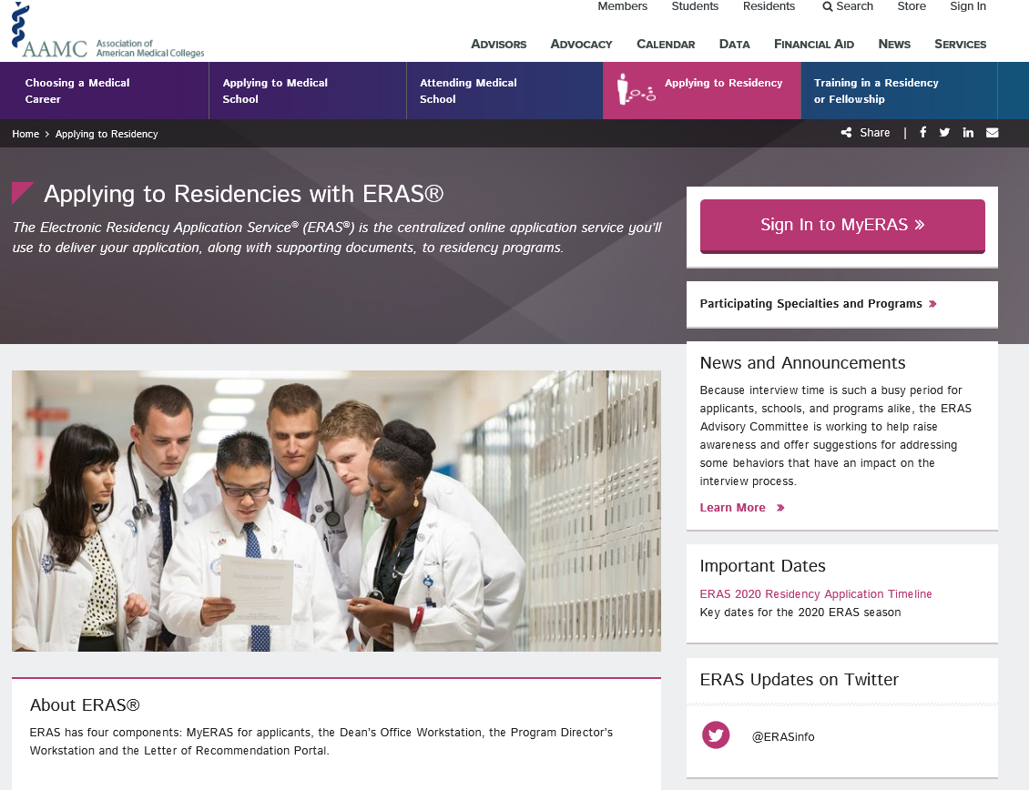
AAMC: ERAS
https://students-residents.aamc.org/applying-residency/applying-residencies-eras/
Recommend start here and read “Applying smart for Residency”

Slide 5
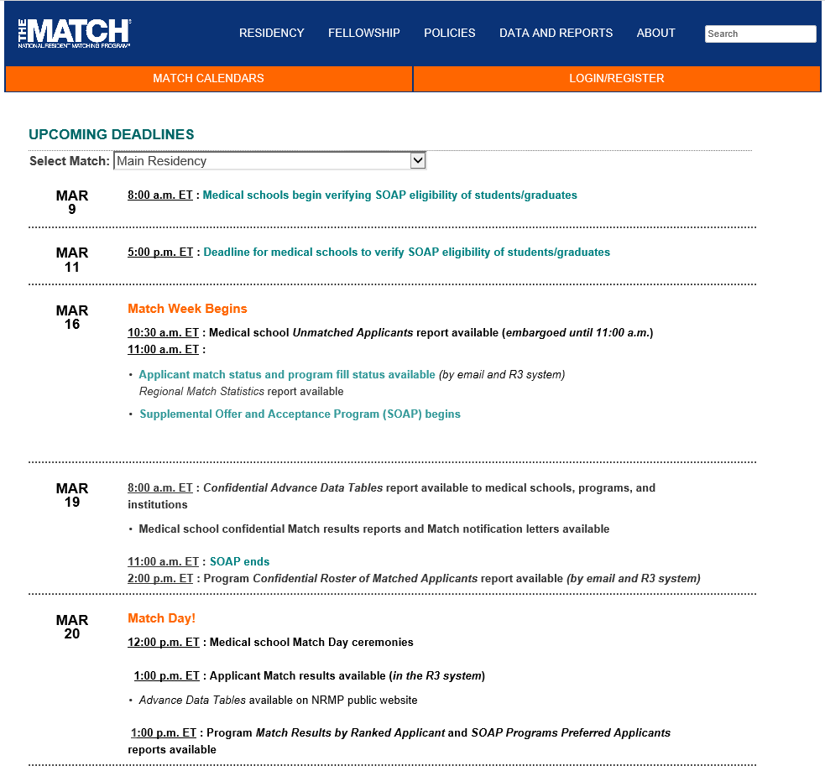
Match website has lots of important information: www.nrmp.org
Click here for the calendar
Scroll down for the 2020
calendar

Slide 6
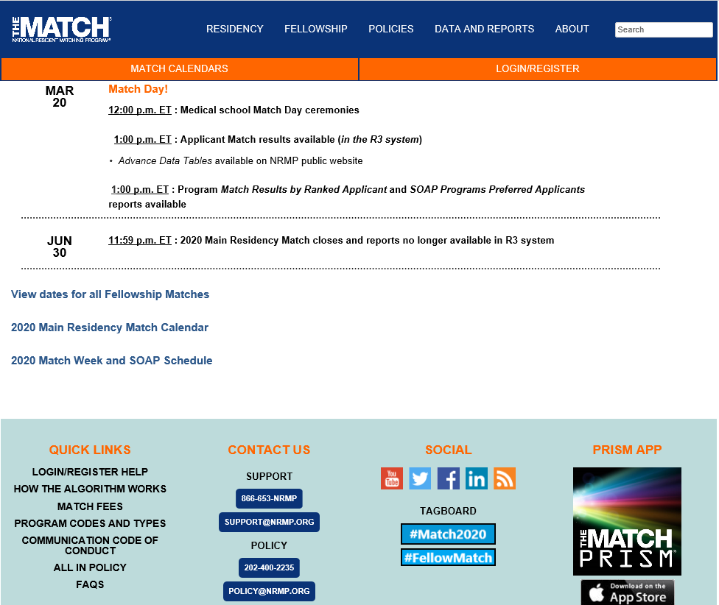
For the 2020 calendar:
Click here for the pdf:

Slide 7
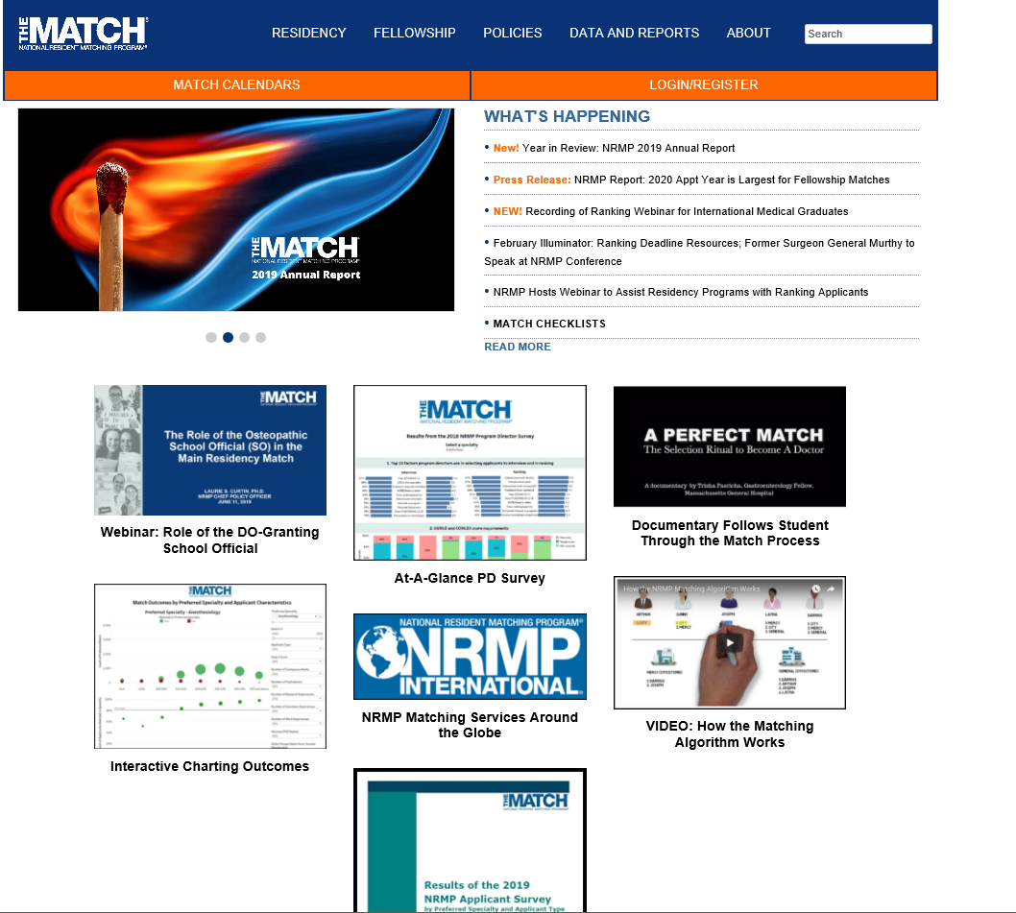
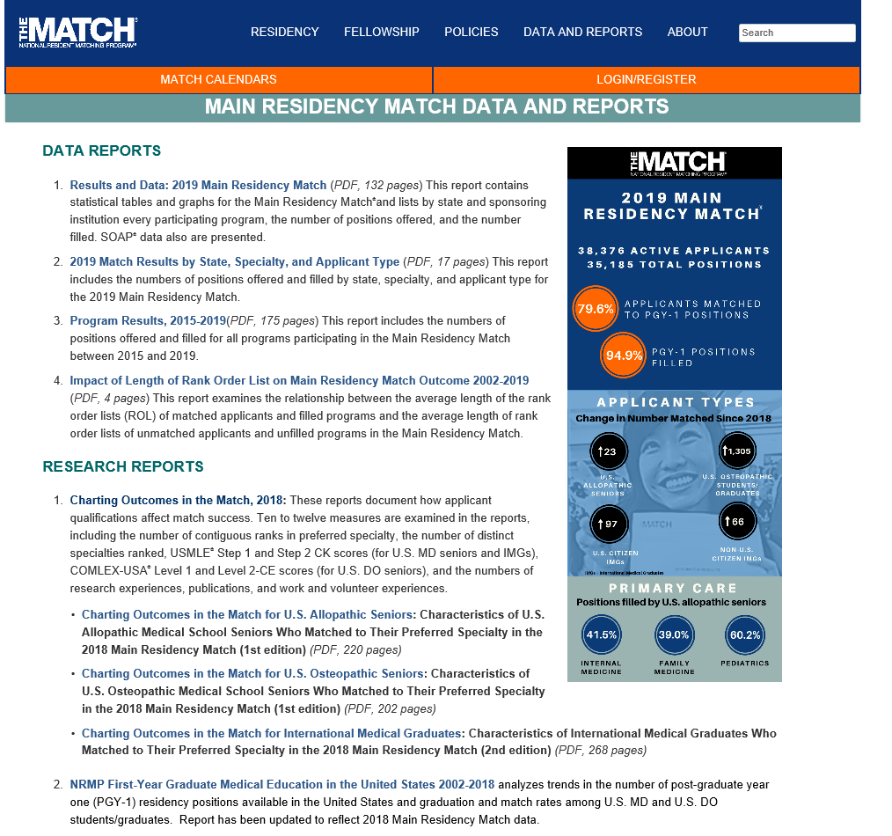
More info:

Slide 8
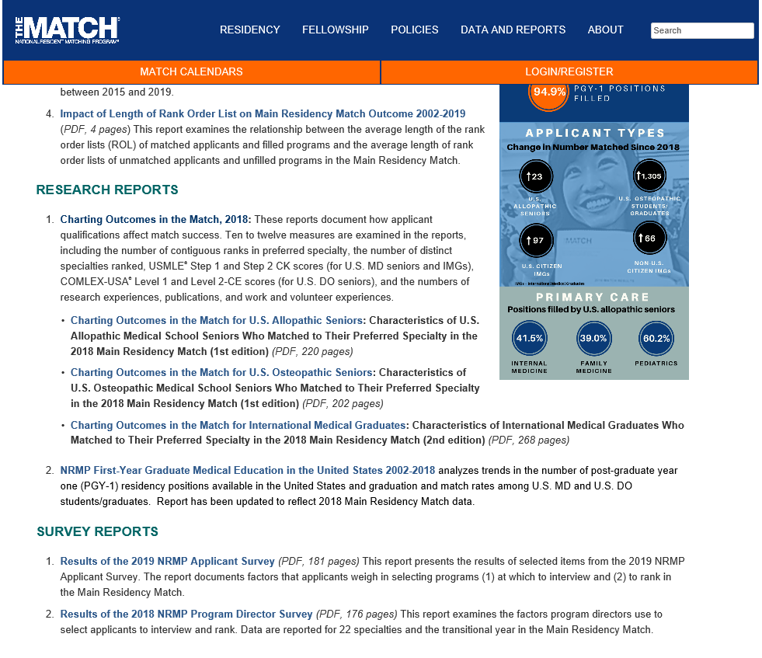
NRMP Surveys: Worth a look
What applicants did last year- making choices?
What did program directors use to select applicants?

Slide 9
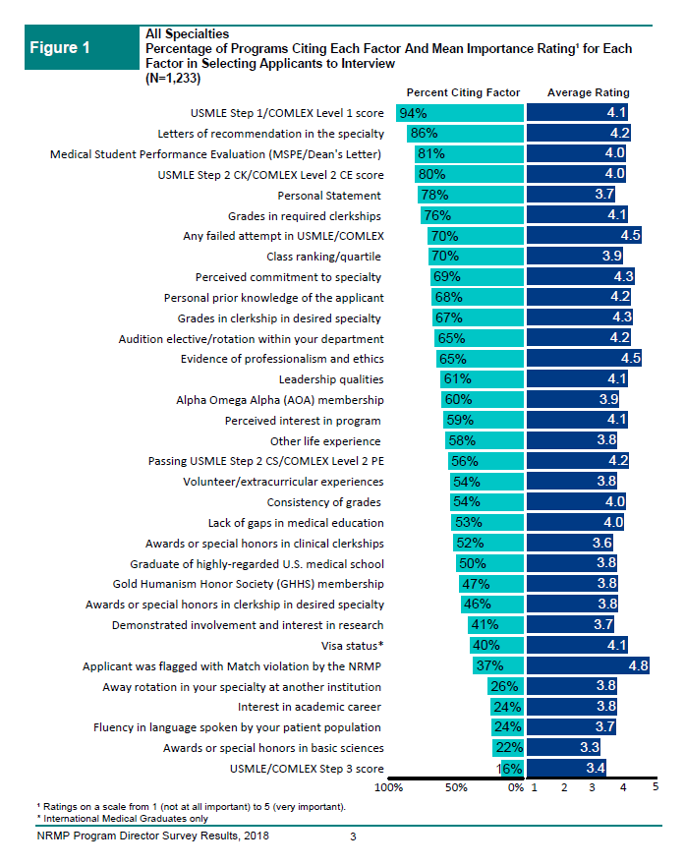
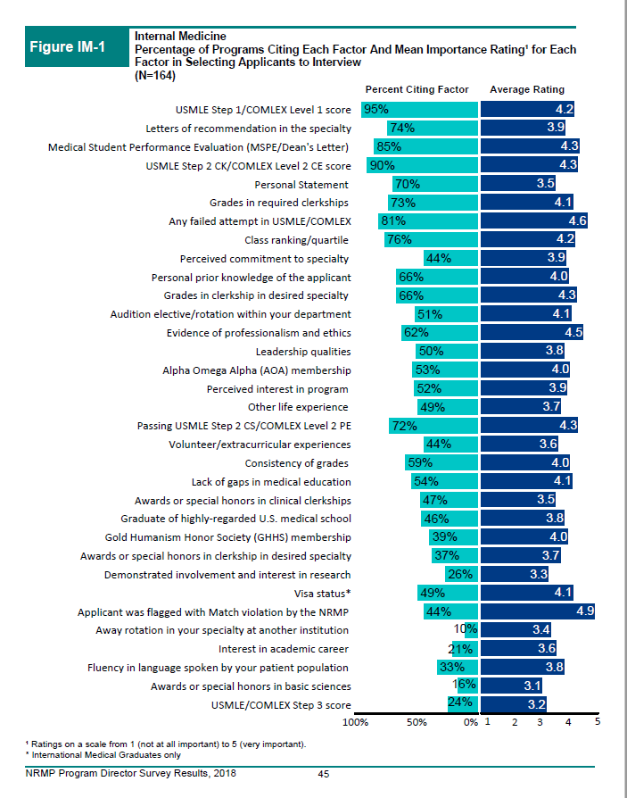
From the Program Director survey: View All Specialties or by Specialty

Slide 10
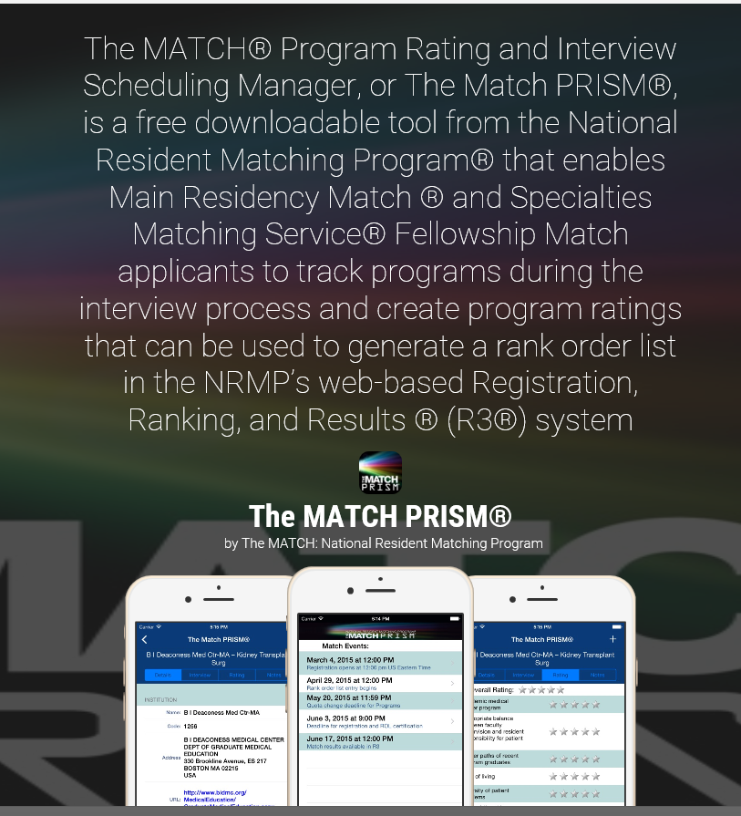
And there’s an app…
https://appadvice.com/app/the-match-prism/687444845

Slide 11
Developing Program List
Where to look?
Geography
Size of program
Style of program
Availability of fellowships
Cost of living, size of city
How many hospitals/locations
Away rotations
Electives available
Unique focus/practice opportunity
Research opportunity
Faculty

Slide 12
Developing Program List
How to decide?
Ask faculty/advisors
Ask other students
Ask residents
Have someone look at your program list
Be realistic about your program list

Slide 13
Questions?
Please ask for help if you need…
Please ask for help if you are confused…
Please ask for help if you don’t know what you need…

